Slide 1
Machine Learning
FOR dUMMYS

Slide 2
Machine Learning
„The field of study that gives computers the ability to learn without being explicitly programmed.”
/Arthur Samuel/

Slide 3
Motivation
Database mining
Self programming applications
Understanding human learning

Slide 4
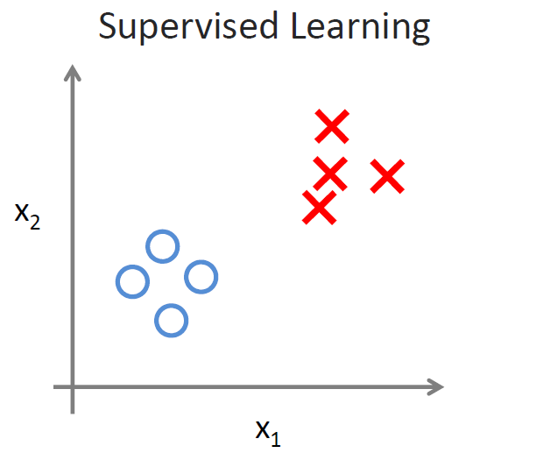
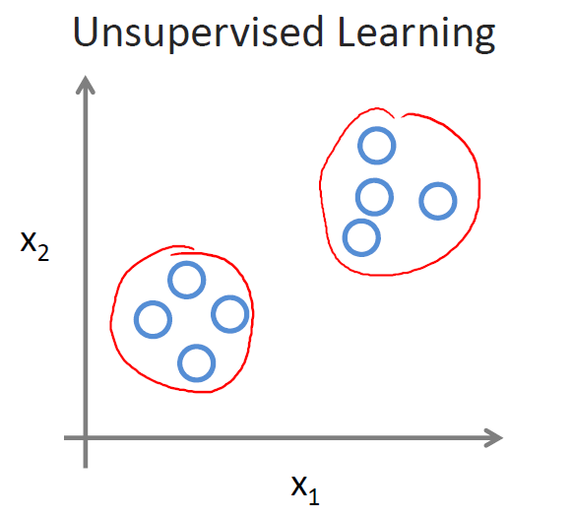
Algorithms can be…
Supervised learning („right answer” is given)
Regression (predict continous valued output)
Classification (discrete valued output, 0 or 1)
Unsupervised learning
Market segmentation
News article grouping

Slide 5
Linear Regression

Slide 6
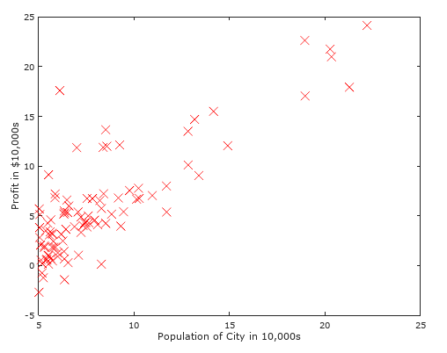
Example
One variable linear regression
You have data for profits and populations from different cities. You would like to use this data to help you select which city to expand your food truck company.
Ex.m

Slide 7
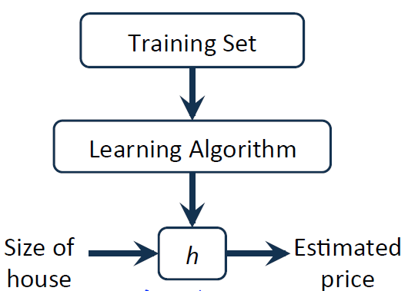
Model
m – number of training examples
x – input variable
y – output variable
(x, y) – one training example
(x^{(i)}, y^{(i)}) – i^{th} training example
Population
of the city
Estimated
profit
X
hypothesis
Y

Slide 8
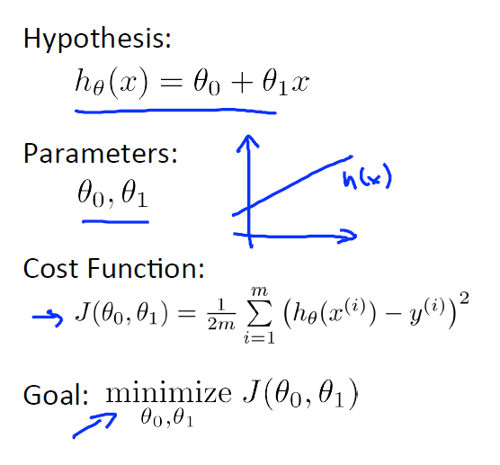
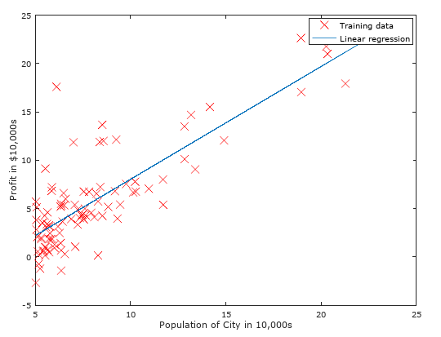
Hypothesys & Cost Function (linear Case)

Slide 9
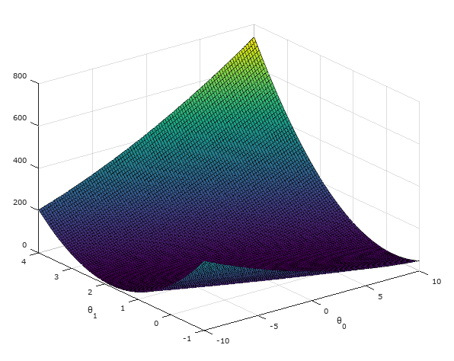
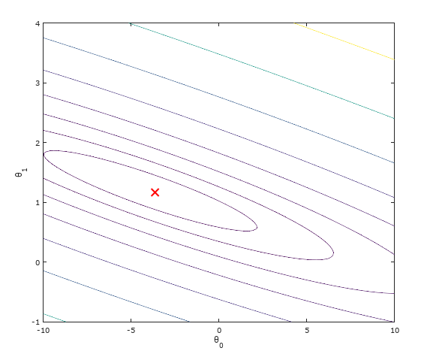
Cost Function

Slide 10
Gradient descent algorithm
Have some cost function: J(Θ₀, Θ₁)
Want to minimize cost function
Outline:
Start with some Θ₀, Θ₁ (Θ₀=0, Θ₁ =0)
Keep changing Θ₀, Θ₁ to reduce J(Θ₀, Θ₁) until we hopefully end up at a minimum.

Slide 11
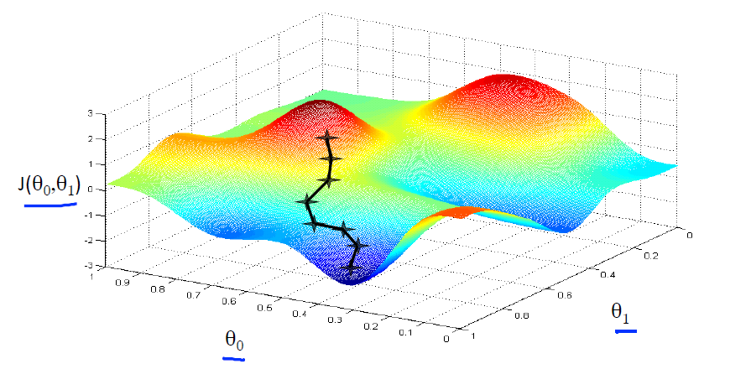
Gradient Descent visualization I

Slide 12
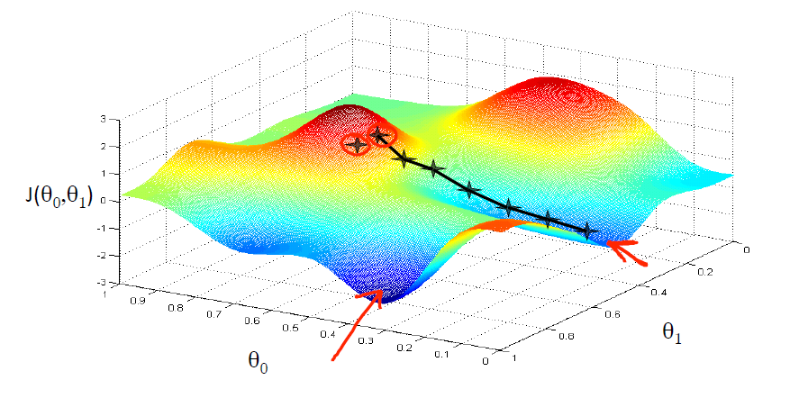
Gradient Descent visualization II

Slide 13
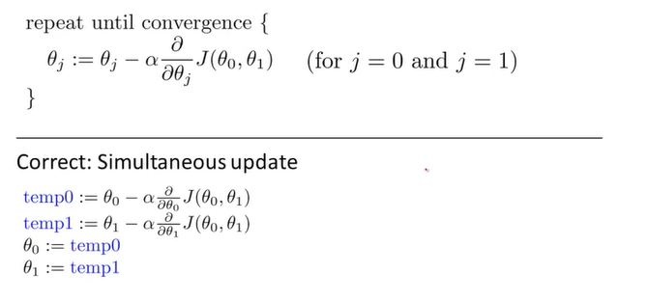
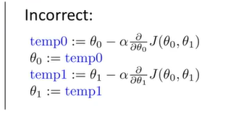
Gradient descent algorithm

Slide 14
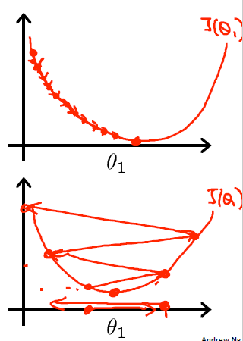
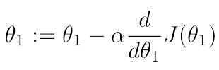
Learning rate I.
If α is too small, gradient descent can be slow.
If α is too large, gradient descent can overshoot the minimum. It may fail to converge, or even diverge.

Slide 15
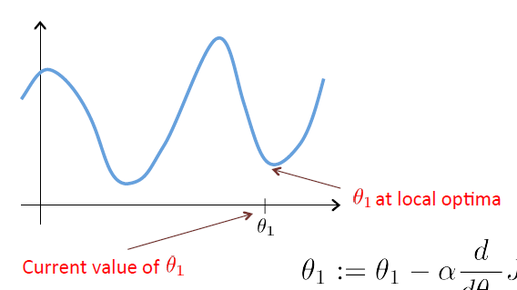
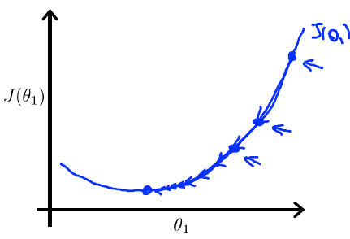
Learning Rate II.
Gradient descent can converge to a local minimum, even with a fixed learning rate.
As we approach a local minimum, gradient descent will automatically take smaller steps. No need to decrease α over time.

Slide 16
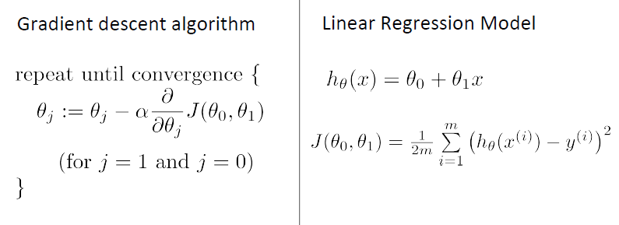
Modell integration I.

Slide 17
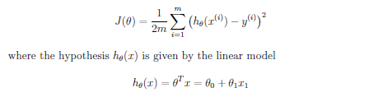
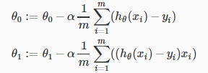
Modell integration II.
„Batch” Gradient Descent: Each step of gradient descent uses all the training examples.

Slide 18
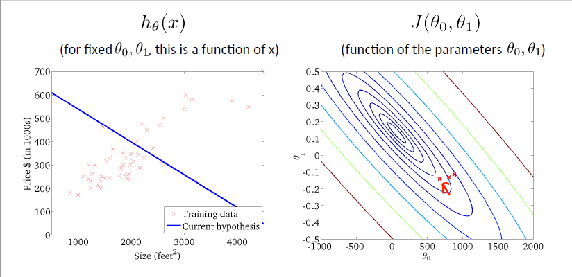
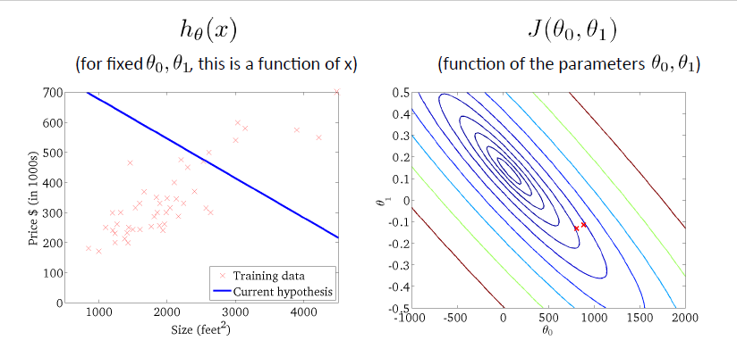
Example

Slide 19
Example

Slide 20
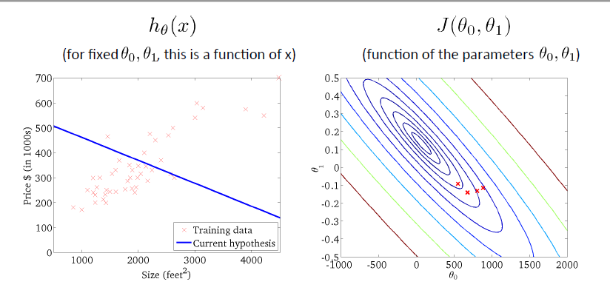
Example

Slide 21
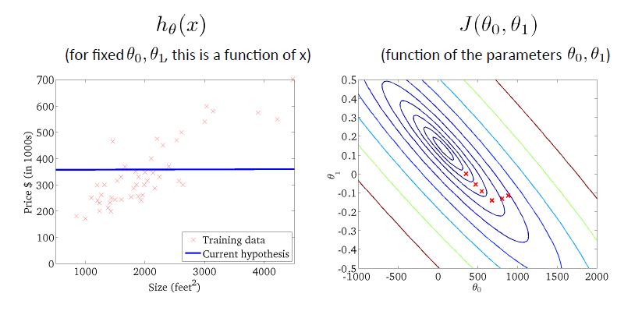
Example

Slide 22
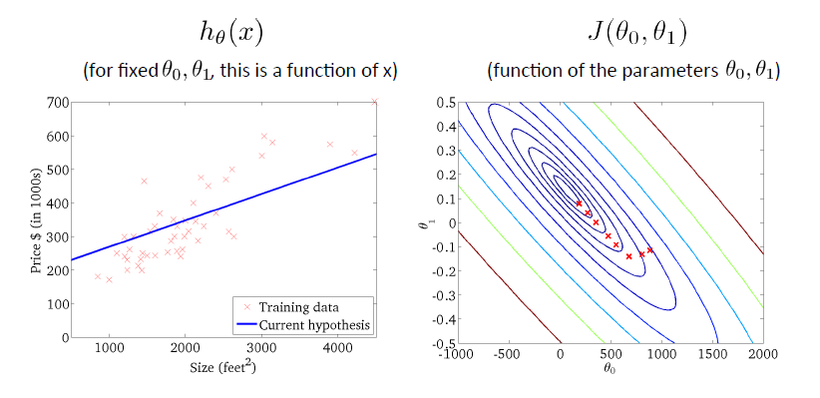
Example

Slide 23
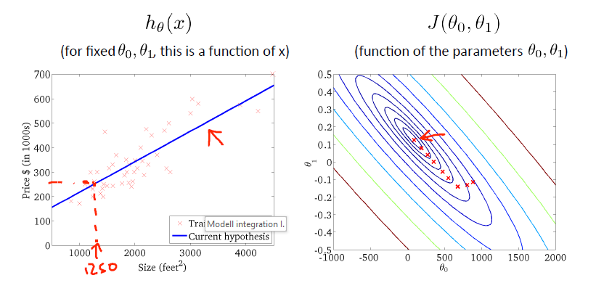
Example

Slide 24
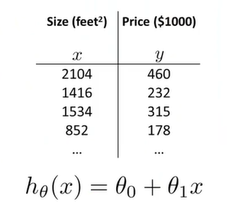
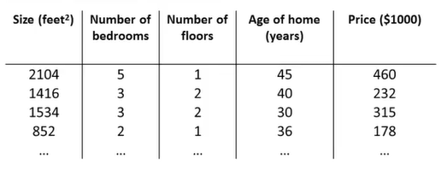
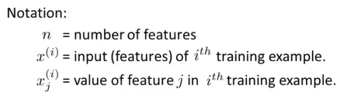
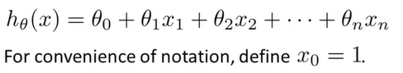
Multiple variables

Slide 25
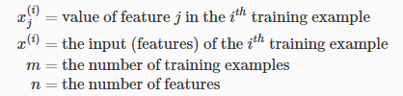
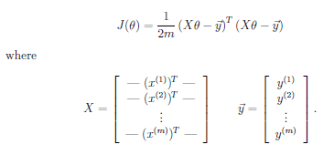

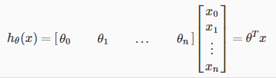
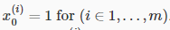
Multiple features Linear regression modell
. This allows us to do matrix operations
This allows us to do matrix operations.

Slide 26
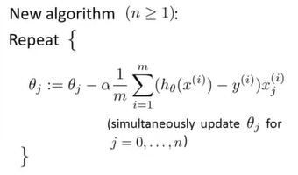
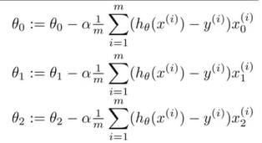
Modifing Gradient Descent algorithm

Slide 27
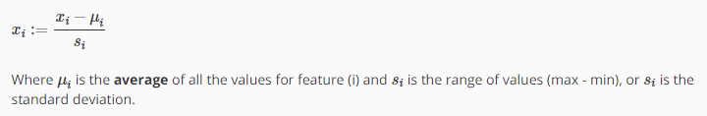
Feature Scaling
If the variables have different ranges it can slow down the convergence
For example: x₁ = size (0-2000 m²) x₂ = number of bedrooms (1-5)
Get every feature into approximately a -1… +1 range.
Feature scaling
Mean Normalization

Slide 28
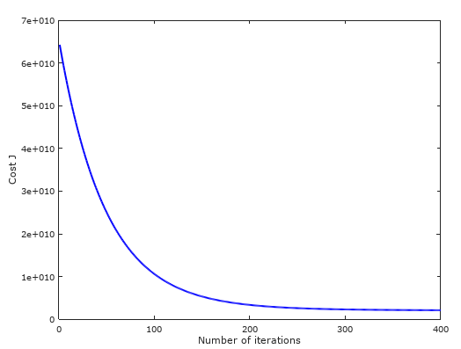
Debugging Gradient descent
Automatic convergence test
Declare convergence if J(Θ) decreases by less than ϵ in one operation.
If gradient descent not working properly use smaller α
If α is too small: slow convergence

Slide 29
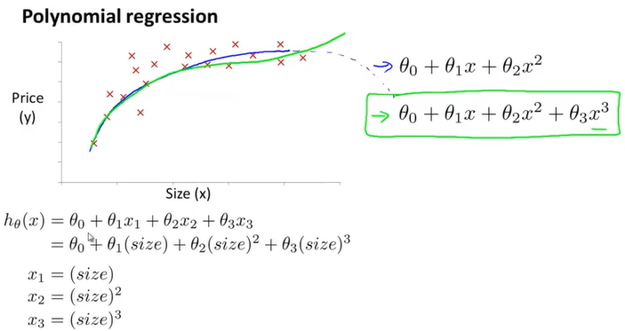
Polinomial regression

Slide 30
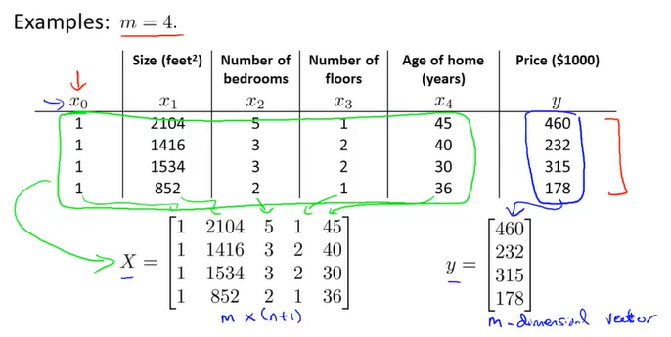
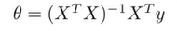
Normal equation

Slide 31
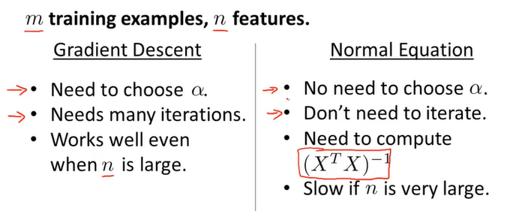
Overview
In case of non invertible matrix:
Octave: pinv() function (pseudo inverse

Slide 32
Logistic Regression

Slide 33
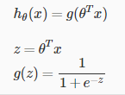
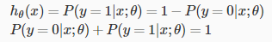
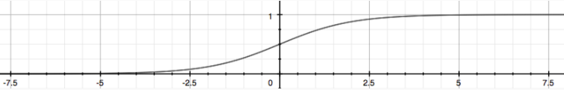
Classification
y = 0 or 1
Sigmoid Function (also called Logistic Function)
h(x) will give us the probability that our output is 1.

Slide 34
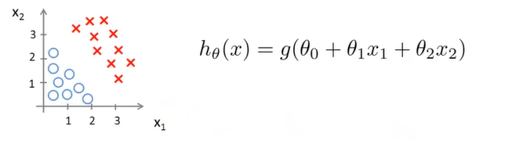
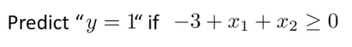
Decision boundary - Linear

Slide 35
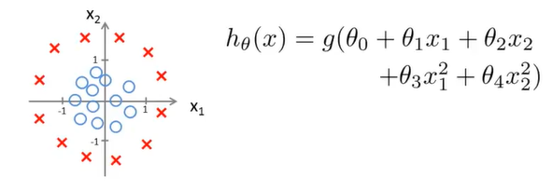
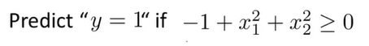
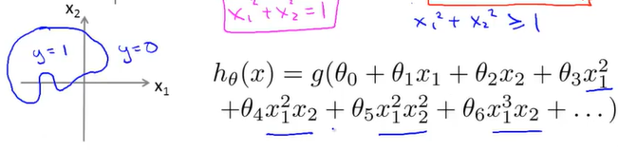
Decision boundary – Non-Linear

Slide 36
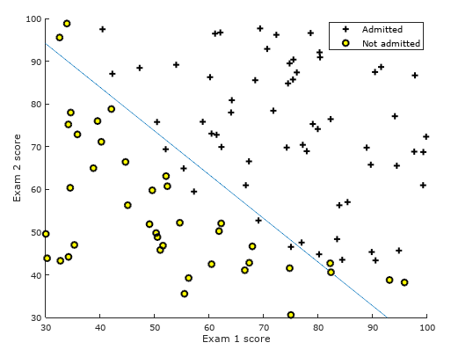

Example
ex2.m and ex2_reg.m

Slide 37



Cost function – Logistic regression
We cannot use the same cost function that we use for linear regression because the Logistic Function will cause the output to be wavy, causing many local optima and it will not be a convex function.
Logistic Regression Cost function:

Slide 38


Cost Function

Slide 39

Optimization

Slide 40



Optimization Example
Built in optimization function in Octave or Matlab:

Slide 41

Multi Class classification

Slide 42





One vs All classification
Train a logistic regression classifier for each class i to predict the probability that y = i.
On a new input x, to make a prediction, pick the class i that maximizes.

Slide 43
Regularization

Slide 44

Linear regression
Overfitting: If we have too many features, the learned hypothesis may fit the training set very well, but fail to generalize to new examples (predict on new examples).

Slide 45

Logistic regression

Slide 46
Possible solutions to reduce overfitting
Reduce number of features
Manually select which features to keep
Model selection algorithm
Regularization
Keep all the features, but reduce magnitude/values of parameters Θ.
Works well when we have a lot of features, each of which contributes a bit to predicting y.

Slide 47


Regulaziation – Linear Regression
Suppose we penalize high rank element and make Θ3, Θ4 really small
NOTE: Θ0 is not penalized
The λ, or lambda, is the regularization parameter. It determines how much the costs of our theta parameters are inflated.

Slide 48


Regularized Gradient descent

Slide 49

Regulaziation – Logistic Regression

Slide 50
Neural Networks

Slide 51

Neuron in the brain

Slide 52

Neuron modell: Logistic unit

Slide 53

Neural Network

Slide 54

Neural Network Model Reprezentation

Slide 55


Slide 56

Neural Network Architecture

Slide 57

Example

Slide 58


Multiple output units: One vs all
Decode information

Slide 59

Cost function
L = total number of layers in the network
s_{l} = number of units (not counting bias unit) in layer l
K = number of output units/classes
Cost function:

Slide 60

Backpropagation Algorithm
"Backpropagation" is neural-network terminology for minimizing our cost function, just like what we were doing with gradient descent in logistic and linear regression. Our goal is to compute min_{Θ}J(Θ)

Slide 61

Gradient computation

Slide 62


Backpropagation algorithm

Slide 63

Backpropagation algorithm

Slide 64
Training a neural network
Randomly initialize the weights
Implement forward propagation to get h_{Θ}(x^{(i)}) for any x^{(i)}
Implement the cost function
Implement backpropagation to compute partial derivatives
Use gradient checking to confirm that your backpropagation works. Then disable gradient checking.
Use gradient descent or a built-in optimization function to minimize the cost function with the weights in theta.

Slide 65
Evaluating a learning algorithm

Slide 66
Model selection: Train/Validation/Test Sets
Training set: 60%
Cross validation set: 20%
Test set: 20%
1 Optimize the parameters in Θ using the training set for each polynomial degree.
2 Find the polynomial degree d with the least error using the cross validation set.
3 Estimate the generalization error using the test set with J_{test}(Θ^{(d)}), (d= from polynomial with lower error) This way, the degree of the polynomial d has not been trained using the test set.

Slide 67

Bias / Variance

Slide 68


Bias / Variance

Slide 69

Linear regression with regularization

Slide 70

Calculate regularization parameter

Slide 71


Learning curve I

Slide 72


Learning curve II.

Slide 73
Debugging Tips
Getting more training examples: Fixes high variance
Trying smaller sets of features: Fixes high variance
Adding features: Fixes high bias
Adding polynomial features: Fixes high bias
Decreasing λ: Fixes high bias
Increasing λ: Fixes high variance.

Slide 74
Further More…
SVM – Support Vector Machine - Large margin
K – means algorithm - Unsupervised learnin classification algorithm
Anomaly detection - Only few positive example, learning mechanism based on the Gaussian distribution.

Slide 75
Thank you for your attention!

Slide 76
Reference
Andrew Ng: Machine Learning Corse (Coursera)
by Stanford University

